Slide 1
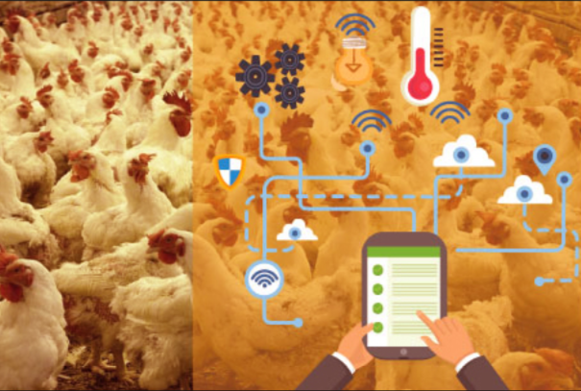
IOT Enabled Smart Poultry Farm

Slide 2
Contents
Introduction
Use of IOT in Poultry Farm
Components Used
Working Process
Conclusion

Slide 3
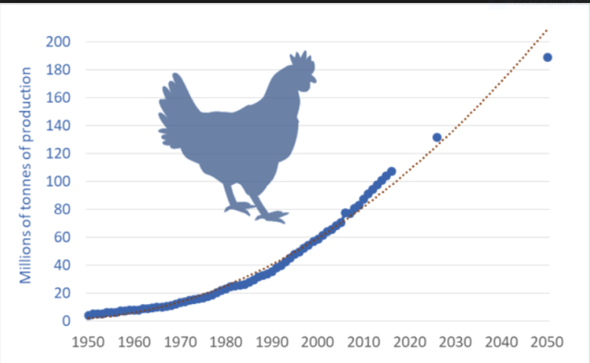
Introduction
Indian Poultry Industry is one of the fastest growing segment in agricultural sector today.
The production of eggs and broilers has been raising at a rate of 8 to 10% per annum
Weather condition is the major problem in poultry farming
Humidity,Temperature,Lighting,Ventilation are the most important variables for the best performance of a poultry farm

Slide 4
Use of IoT in Poultry Farm
IoT proposes the new model by using advanced modern technology to make traditional chicken farming smarter. Smart farm gives the environmental parameter statistics like temperature, humidity, smoke, weather condition etc.
Poultry farm using IoT are design in such way that, environmental conditions can be altered by providing facilities like ventilation, cooling and lightening on rough, wall and floor.
We can remotely monitor environmental parameters in the poultry farm and even water level in the tank.

Slide 5
Hardware Components
NodeMCU is an open source IoT platform which runs on the ESP8266Wi-Fi Soc from Express if systems and hardware which is based on the ESP-12 module
This DHT-11 temperature and humidity sensor features a calibrated digital signal output with the temperature and humidity sensor capability.
It is integrated with a high performance 8-bit micro controller. Its technology ensures the highly reliability and excellent long term stability
Ultrasonic transducers or Ultrasonic sensor are a type of acoustic sensor divided into 3 broad categories: transmitters, receivers, transceivers.
Transmitters convert electrical signals into ultrasound , receivers convert ultrasound into electrical signals Transceivers can both transmit and receive ultrasonic sound.

Slide 6
The Grove - Gas Sensor(MQ2) module is useful for Gas leakage detection (home and industry).
It is suitable for detecting H2, LPG, CH4, CO, Alcohol , Smoke or Propane.
Due to its high sensitivity and Fast response time, measurement can be taken as soon as possible.
A Servomotor is a rotary actuator or linear actuator that allows for precise control of angular or linear position,velocity and acceleration.
It consists of a suitable motor coupled to a sensor for position feedback.
It also requires a relatively sophisticated controller,
often a dedicated module designed specifically for use with servomotors.

Slide 7
An organic light-emitting diode (OLED) is a light-emitting diode (LED) in which the emissive electroluminescent layer is a film of organic compound that emits light in response to an electric current.
This organic layer is situated between two electrodes; typically, at least one of these electrodes is transparent.
OLEDs are used to create digital displays in devices such as television screens, computer monitors, portable systems such as smart phones , handheld game consoles and PDAs.
Software Components
The Arduino integrated development environment (IDE) is a cross-platform application (for Windows, macOS, Linux) that is written in the programming language Java.
It is used to write and upload programs to Arduino compatible boards, but also, with the help of 3rd party cores, other vendor development boards.

Slide 8
Blynk - The most popular IoT platform to connect your devices to the cloud, design apps to control them, and manage your deployed products at scale.
Node-RED is a flow-based development tool for visual programming developed originally by IBM for wiring together hardware devices, APIs and online services as part of the Internet of Things. Node-RED provides a web browser-based flow editor, which can be used to create JavaScript functions

Slide 9
Working Process
First we will use gas sensor (MQ2 sensor) for detecting the presence of harming gases and sends out the notification to Switch on the Exhaust Fan
DHT sensor is used to check the temperature in the poultry and sends the message whether the temperature is high or low.
Ultrasonic sensor is used to find out the water level in the tank and send the notification whether the water is full and off the motor or the water is empty turn on the motor.
Servomotor is also used for the same water purpose itself and fills the tank periodically.
We use the IBM Watson to Store the data,so that we can get a montly review of the activities.We also use the Node-Red to send data into a corresponded URL
We have created a Mobile App using Blynk where you can get the values and notification’s and can control the farm using this app

Slide 10
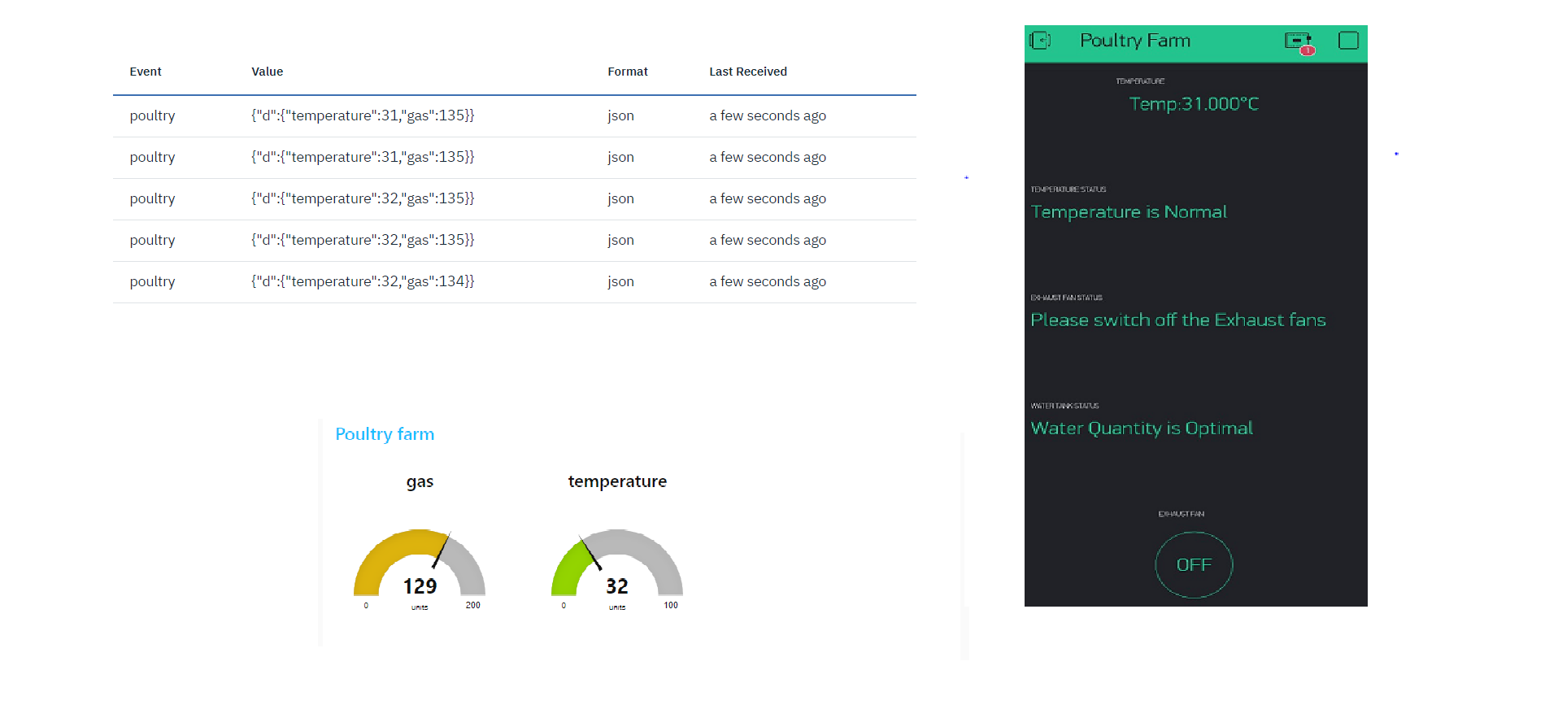

Slide 11
Advantages and Disadvantages
The smart monitoring of different parameters like temperature,gas,light,water by using sensor network.
It provides quicker and accurate information about different parameters to farmers.
This System replaces traditional farm into an intelligent farm.
We need to manually Switch On the Exhaust Fan
The Amount of Food Consumed is not Measured

Slide 12
Conclusion
Monitoring environmental parameters in a real time industry are crucial , but this can be done using IoT.
It helps the farmers real time controlled and monitoring environmental aware context parameters.
This smart system can effectively control the farm from any location and reduces the cost time and man power.
This will improve productivity and quality of chickens in poultry farming. In the future advanced IOT based technologies should be use for monitoring and controlling health related parameters of chicken to improve quality and productivity of chickens.

Slide 13
Thank You
Team :- Anonymous
Team Members :- Kevin Joe Ronin
Praneetha Tummala
Pavithra Hosallikar

